Slide 1
Agenda
Day2 | Types of Machine Learning Algorithms Bayesian Learning: Bayes Theorem and Concept Learning, ML and LS error Hypothesis, Naïve Bayes Classifier, Bayesian belief networks, EM Algorithm
https://github.com/profthyagu
http://proftgs.blogspot.com
Gmail1: profthyagu@gmail.com
Gmal2 : innovationscontext@gmail.com
Mobile : 9480123526

Slide 2
1. Classification of Machine Learning Algorithms
Based on Depth of Learning
Based on Type of learning

Slide 3
1.1 Based on Depth of Learning
Shallow Learning
Algorithms with Few Layers
Better for Less Complex and Smaller Data sets
Eg: Logistic Regression and Support vector Machines
Deep Learning
New technique that uses many layers of neural network ( a model based on the structure of human brain)
Useful when the target function is very complex and data sets are very large.

Slide 4
1.2 Based on Type of Learning
Supervised Learning
X and Y
Given an observation X what is the best label for Y
Unsupervised Learning
X
Given a set of X cluster or summarize them
Reinforcement Learning
Determine what to do based on Rewards and punishments

Slide 5
1.2.1. Supervised Learning
Here the training (labeled) data set containing input/predictors and output will be fed to the machine. The machine with the help of algorithm analyze the data set and generates a suitable model /function that best describes the input data. i.e it generates a function f(X) which makes best estimation of the output Y = f(X) for given X.
The generated model / function can be used to predict the output values for new data based on those relationships which it learned from the previous data sets.
When Y is discrete (True /False, ..) – Classification
When X is continuous (Real Numbers )- Regression

Slide 6
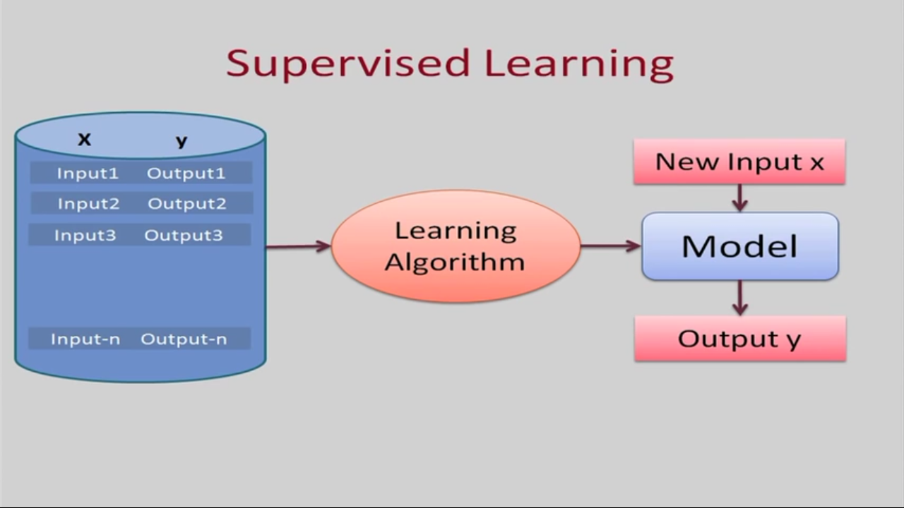

Supervised Learning
(Train Me )

Slide 7

Supervised Learning Use cases
Cortana or any speech automated system in your mobile phone trains your voice and then starts working based on this training. This is an application of Supervised Learning

Slide 8

Supervised Learning Use cases
Weather Apps
Predicts the upcoming weather by analyzing the parameters for a given time on some prior knowledge (when its sunny, temperature is higher; when its cloudy, humidity is higher, etc.).

Slide 9

Supervised Learning Use cases
Biometric Attendance
In Biometric Attendance you can train the machine with inputs of your biometric identity – it can be your thumb, iris or ear-lobe, etc. Once the machine is trained it can validate your future input and can easily identify you.

Slide 10
Types of Supervised Learning (Task Driven . Develop Prediction Model based on Input and Output Data)
Classification ( Discrete)
Logistic Regression
KNN
Decision Trees
Support Vector Machines
Naïve Bayesian
Discriminant Analysis
Random Forest
AdaBoost
Neural Networks
Regression ( Continuous)
Linear Regression
SVR
GPR
Ensemble Methods

Slide 11
1.2.2: Unsupervised Learning
This approach is data driven . The computer is trained with unlabeled input data.
These algorithms try to use techniques on the input data to mine for rules, detect patterns, and summarize and group the data points which help in deriving meaningful insights and describe the data better to the users.
Mathematically, Unsupervised learning is where you only have input data (X) and no corresponding output variables.
The goal for unsupervised learning is to model the underlying structure or distribution in the data in order to learn more about the data

Slide 12
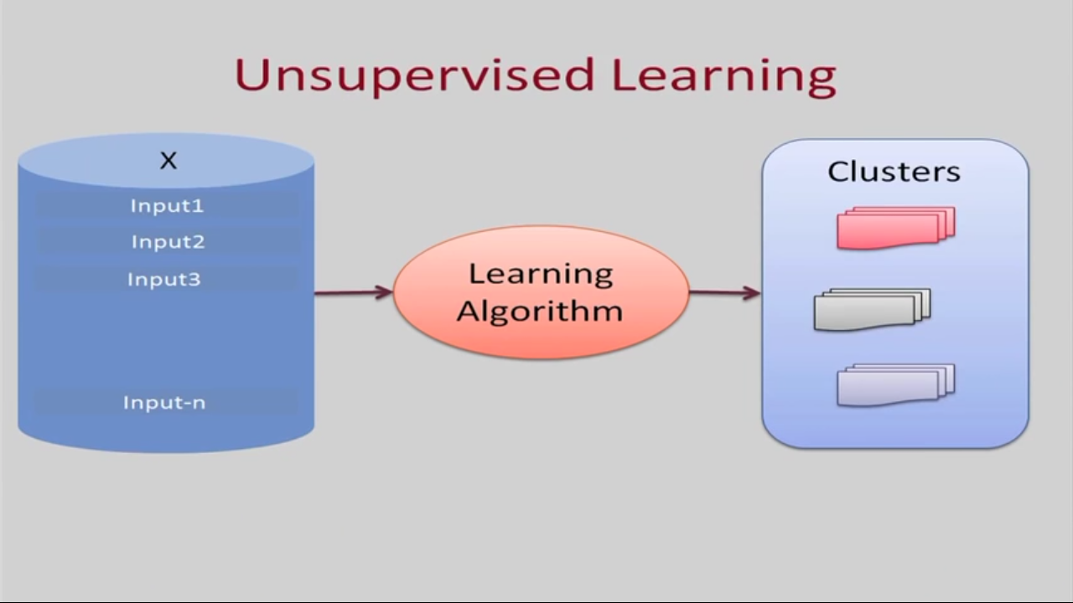

Unsupervised Learning
(I am Self Learner)

Slide 13
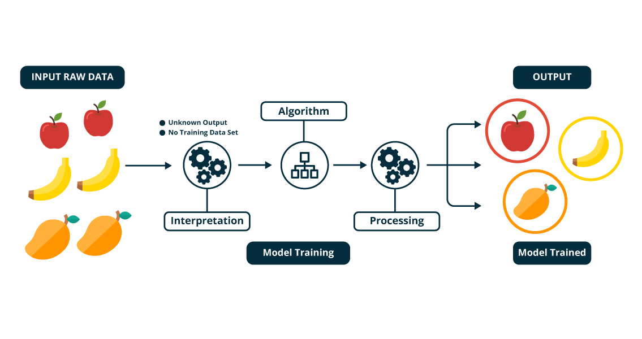

Slide 14

Unsupervised Learning Use cases
A friend invites you to his party where you meet totally strangers. Now you will classify them using unsupervised learning (no prior knowledge) and this classification can be on the basis of gender, age group, dressing, educational qualification or whatever way you would like. Since you didn’t have any prior knowledge about people and so you just classified them “on-the-go”.

Slide 15

Unsupervised Learning Use cases
Let’s suppose you have never seen a Football match before and by chance watch a video on internet, now you can classify players on the basis of different criterion like Players wearing the same sort of kits are in one class, Players of one style are in one class (players, goal keeper, referee), or on the basis of playing style(attacker or defender) or whatever way you would observe, you can classify it.

Slide 16
Types of Unsupervised Learning
Clustering
K Means Clustering
Hierarchical Clustering
Gaussian Mixture Models
Genetic Algorithms
Artificial Neural Networks
Dimensionality Reduction
Tensor Decomposition
Principal Component Analysis
Multidimensional statistics
Random Projection
Association Rules

Slide 17
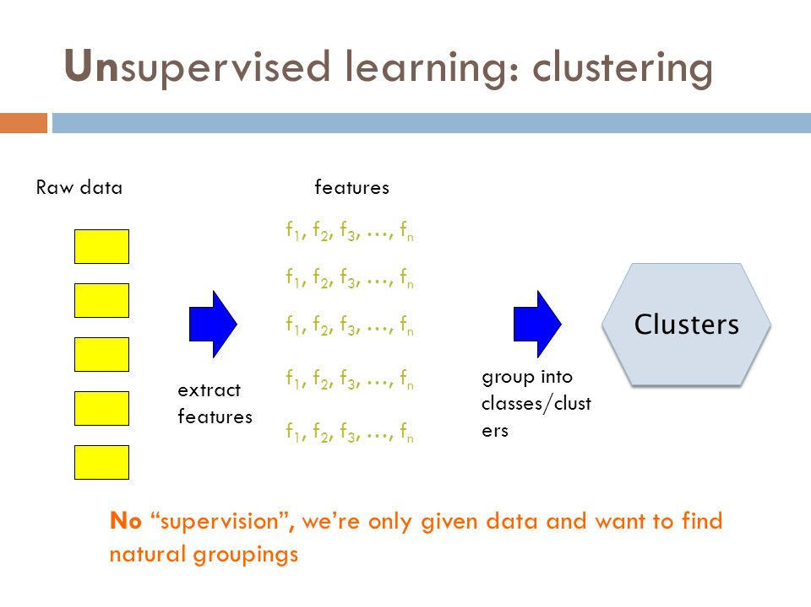

Slide 18
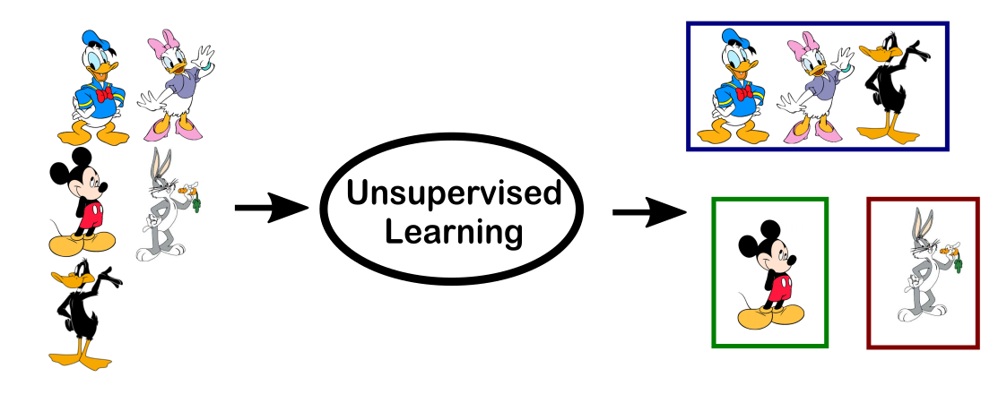

Slide 19
1.3 Reinforcement Learning
This method aims at using observations gathered from the interaction with the environment to take actions that would maximize the reward or minimize the risk.
Reinforcement learning algorithm (called the agent) continuously learns from the environment in an iterative fashion.
Reinforcement learning can be thought of as a hit and trial method of learning. The machine gets a Reward or Penalty point for each action it performs. If the option is correct, the machine gains the reward point or gets a penalty point in case of a wrong response.
Reinforcement Learning
(My life, My rules!
Rewards
(Hit & Trial))

Slide 20
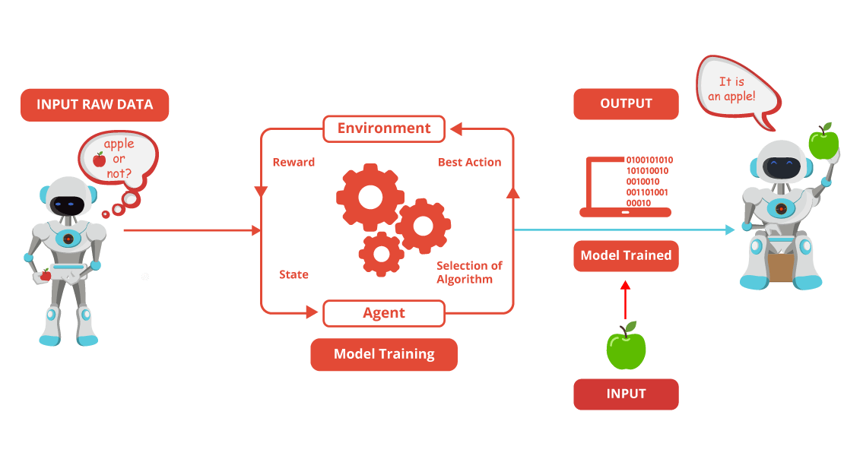

Slide 21
Let see how Pavlov trained his dog using reinforcement training?
Pavlov divided the training of his dog into four stages.
In the first part, Pavlov gave meat to the dog, and in response to the meat, the dog started salivating.
In the next stage he created a sound with a bell, but this time the dogs did not respond anything.
In the third stage, he tried to train his dog by using the bell and then giving them food. Seeing the food the dog started salivating.
Eventually, the dogs started salivating just after hearing the bell, even if the food was not given as the dog was reinforced that whenever the master will ring the bell, he will get the food.

Slide 22
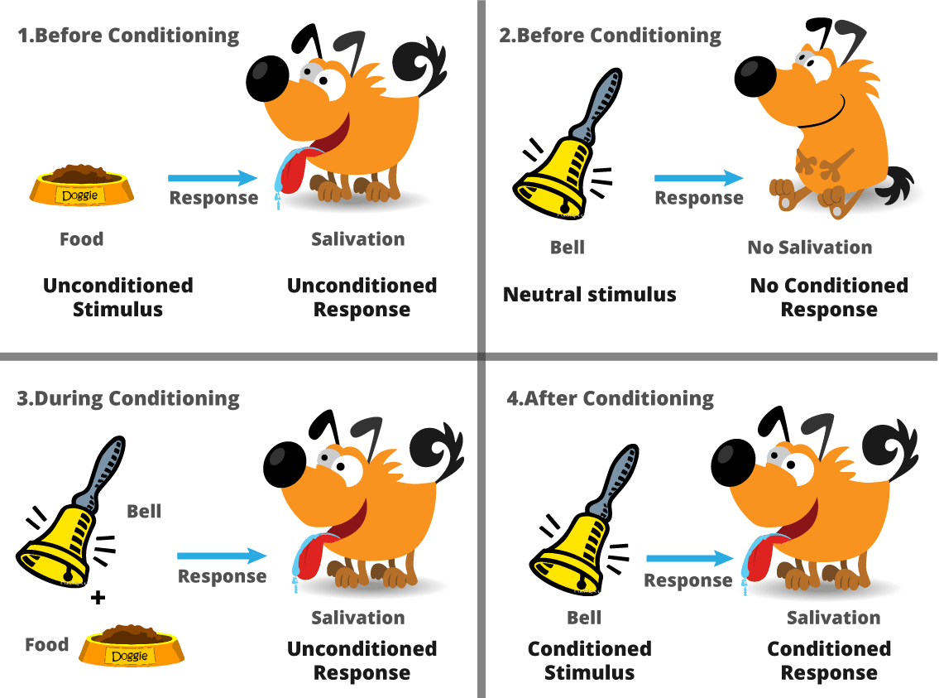

Slide 23
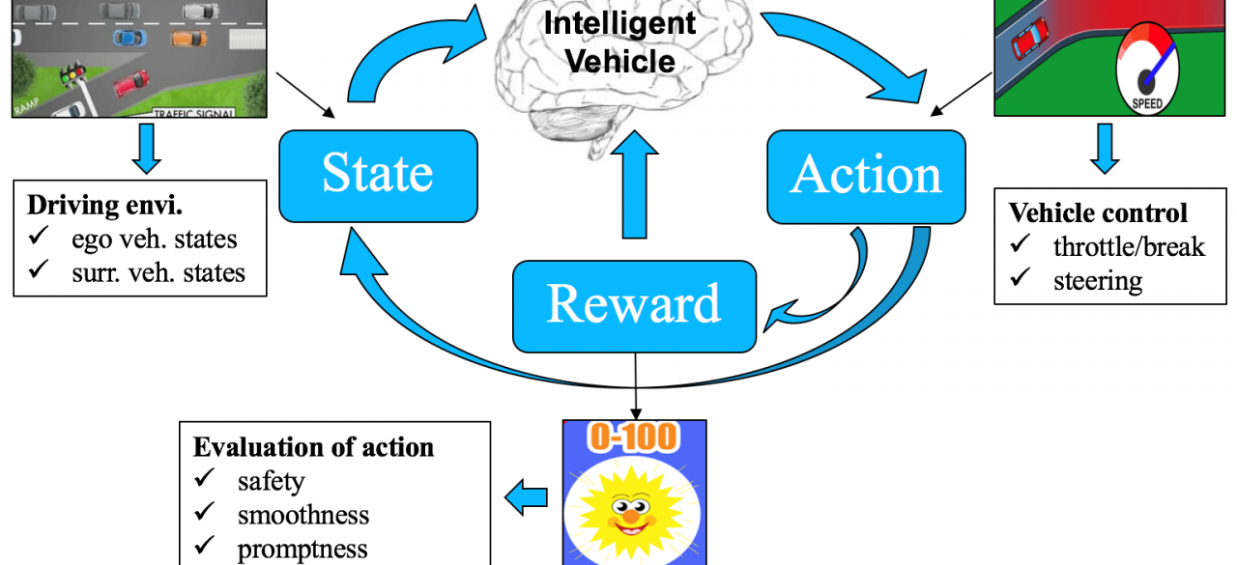

Slide 24
Types of Reinforcement Learning Algorithms
Q-Learning
Temporal Difference (TD)
Deep Adversarial Networks

Slide 25
Table1: Examples of Types of Machine Learning Algorithms / Problem Solving Approaches
Type | Model /Algorithm or Task | Usage Examples in Business
Supervised | Neural network | ■ Predicting financial results ■ Fraud detection
Supervised | Classification and/or Regression | ■ Spam filtering ■ Fraud detection
Supervised | Decision tree | ■ Risk assessment ■ Threat management systems ■ Any optimization problem where an exhaustive search is not feasible

Slide 26
Table1: Examples of Types of Machine Learning Algorithms / Problem Solving Approaches
Type | Model /Algorithm or Task | Usage Examples in Business
Unsupervised | Cluster analysis | ■ Financial transactions ■ Streaming analytics in IoT ■ Underwriting in insurance
Unsupervised | Pattern recognition | ■ Spam detection ■ Biometrics ■ Identity management
Unsupervised | Association rule learning | ■ Security and intrusion detection ■ Bioinformatics ■Manufacturing and Assembly

Slide 27
2. Bayesian Learning
Bayes Theorem
MAP, ML hypotheses
Relation to Concept Learning
MAP learners
Maximum likelihood and Least Squared Error hypothesis
Naive Bayes learner
Example: Learning over text data
Bayesian belief networks
Expectation Maximization algorithm

Slide 28
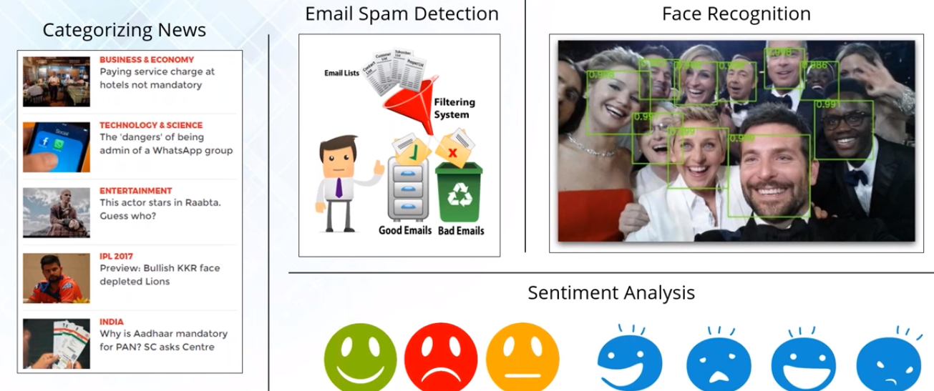

Use cases

Slide 29
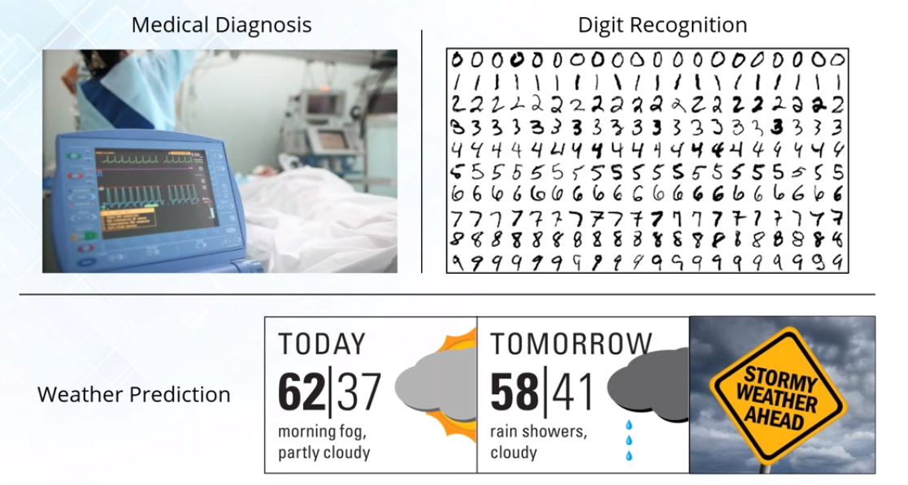
Use cases

Slide 30
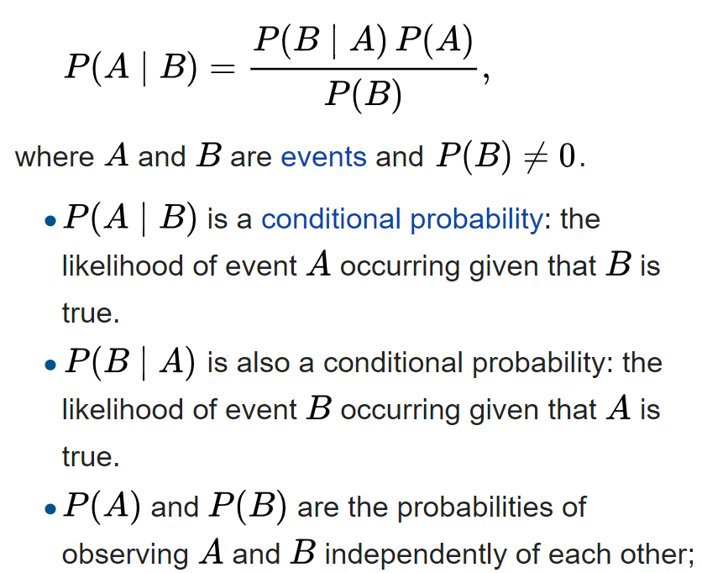
2.1 Bayes Theorem : Mathematical Form
Bayes' theorem is stated mathematically as the following equation

Slide 31
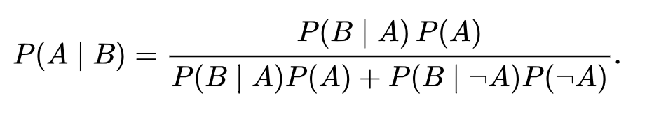
Alternative form

Slide 32
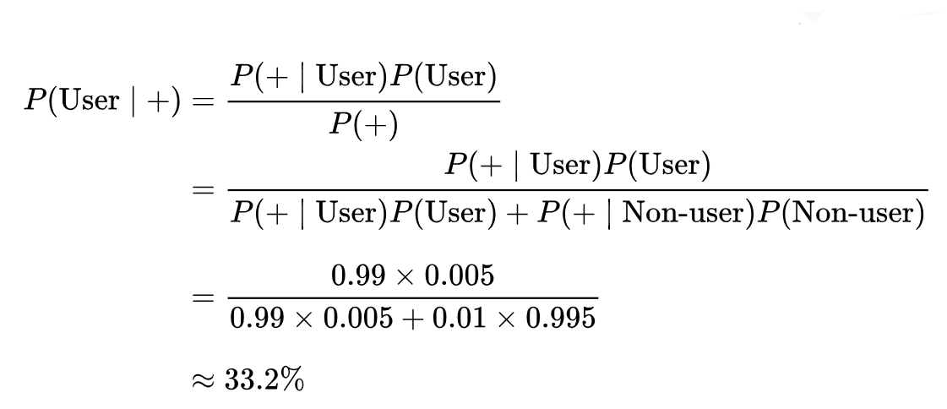
Example of Bayes Theorem
P(A ∣ B) = P(B ∣ A)P(A) / P(B)
Consider a drug test that is 99 percent sensitive(the true positive rate) and 99 percent specific (the true negative rate). If half a percent (0.5 percent) of people use a drug, what is the probability a random person with a positive test actually is a user?

Slide 33
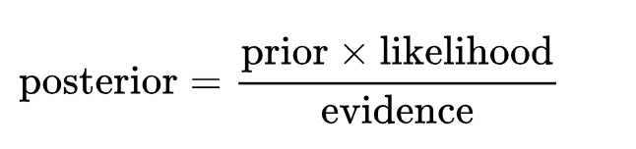
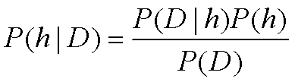
Bayes Theorem : For Hypothesis and Training Data
P(h) = prior (initial) probability that hypothesis h holds , before we observed any training data.
P(D) = prior probability of training data D
P(h|D) = posterior probability of h given D (it holds after we have seen the training data D)
P(D|h) = probability of observing data D given some world in which hypothesis h holds.

Slide 34
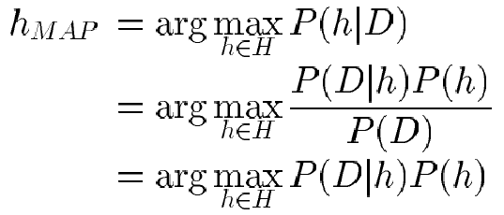
2.2.1 Maximum a posterior (MAP) hypothesis
In many learning scenarios , the learner considers some set of candidate hypotheses H and is interested in finding the most probable hypotheses hЄH given the observed data D .
Any such maximally probable hypothesis is called a maximum posteriori (MAP) hypothesis h_{MAP}:

Slide 35
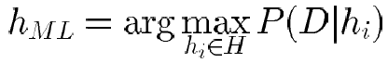
2.2.2Maximum Likelihood
In some cases we will assume that every hypothesis in H is equally probable a priori (P(h_{i}) = P(h_{j}) for all h_{i} in H )
In this case we can further simplify and need only consider the term P(D|h) to find the most probable hypothesis.
P(D|h) is often called the likelihood of the data D given h and any hypothesis that maximizes P(D|h) is called a Maximum likelihood (ML) hypothesis h_{ML}

Slide 36
An Example : Cancer Patient Diagnosis
To illustrate Bayes Rule , Consider a medical diagnosis problem in which there are two alternative hypotheses :
That the patient has a particular form of cancer and
That the patient does not.
The available data is from a particular laboratory test with two possible outcomes :
+ : positive
- : negative

Slide 37
Example : Medical Cancer Test Details of Patient
A patient takes a lab test and the result comes back positive. The test returns a correct positive result in only 98% of the cases in which the disease is actually present, and a correct negative result in only 97% of the cases in which the disease is not present. Furthermore, .008 of the entire population have this cancer.
P(cancer) = P(¬cancer) =
P(+|cancer) = P(−|cancer) =
P(+|¬cancer) = P(−|¬cancer) =
0.008
0.992
0.98
0.02
0.03
0.97

Slide 38
Example : Does patient have cancer or not?
The Maximum a posterior hypothesis for Patient having cancer/no cancer :
cancer_{MAP} = P(+|Cancer) P(cancer) = (0.98)(0.008) = 0.0078
¬cancer_{MAP} = P(¬ |Cancer) P(cancer) =(0.03)(0.992) = 0.0298

Slide 39
2.3 Relation to Concept Learning
Assume that the learner considers some finite hypothesis space H defined over the instance space X , in which the task is to learn some target concept c: X-> {0,1}
Assume fixed set of instances <x₁,…, x_{m}>
Assume D is the set of classifications: D = <c(x₁),…,c(x_{m})>
Assume that the learner has given some sequence of training examples <<x1,d1><x2,d2>,…………………..<xm, dm>> where xi is some instance from X and where di is the target value of xi (i.e di= c(xi)).

Slide 40
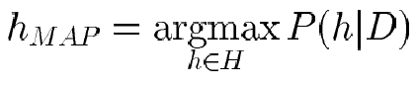
Brute Force MAP Learning Algorithm
For each hypothesis h in H, calculate the posterior probability
Output the hypothesis h_{MAP} with the highest posterior probability

Slide 41
Assumptions
The probability distribution P(h) and P(D|h) is chosen to be consistent with the following assumptions :
The training data D is noise free( i.e. di = c(xi))
The target concept c is contained in the hypothesis space H
We have no a priori reason to believe that any hypothesis is more probable than any other.

Slide 42
The Values of P(h) and P(D|h)
Choose P(h) to be uniform distribution
P(h) = 1/|H| for all h in H
Choose P(D|h):
1 if di =h(xi) for all di in D(h consistent with D)
0 otherwise
P(D|h) =

Slide 43
Two cases
By Applying Bayes theorem
Case1 : When h is inconsistent with training data D:
P(h|D) = 0.P(h)/P(D) = 0
Case 2: When h consistent with D , we have
P(h|D) = (1*1/|H|)/(|VSH,D|/|H|)
= 1/|VSH,D|
Where P(D) = |VSH,D|/ |H| and |VSH,D| is the subset of hypotheses from H that are consistent with D.

Slide 44
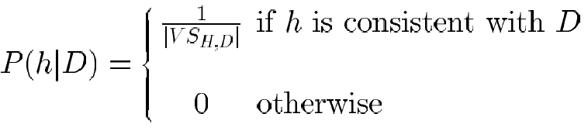
To Summarize
To summarize , Bayes theorem implies that the posterior probability P(h|D) under our assumed P(h) and P(D|h) is

Slide 45
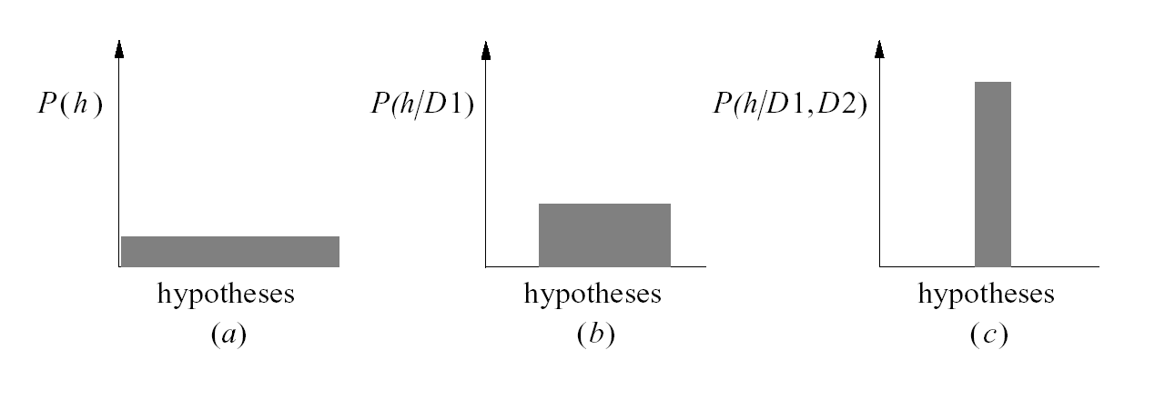
2.4 MAP hypothesis and Consistent Learners

Slide 46
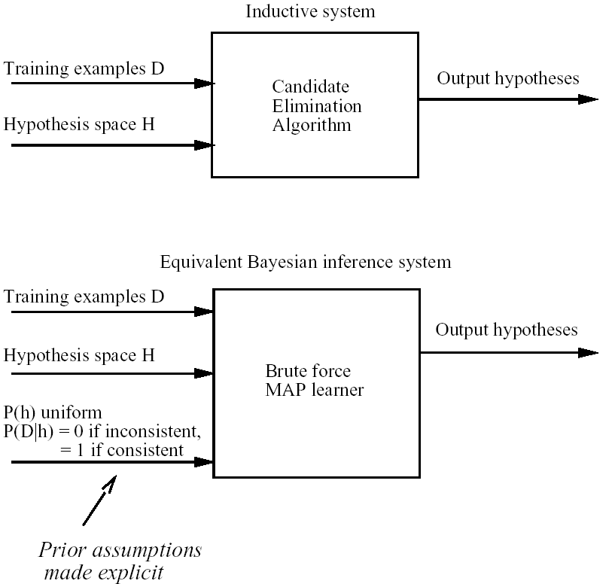
Characterizing Learning Algorithms by Equivalent MAP Learners

Slide 47
2.5 Maximum likelihood and Least Squared Error hypothesis
A straightforward Bayesian analysis will show that under certain assumptions any learning algorithm that minimizes the squared error between the output hypothesis predictions and the training data will output a maximum likelihood hypothesis.

Slide 48
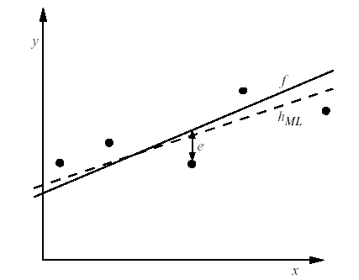
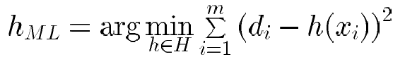
Learning A Real Valued Function
Consider any real-valued target function f
Training examples <x_{i}, d_{i}>, where d_{i} is noisy training value
d_{i} = f(x_{i}) + e_{i}
e_{i} is random variable (noise) drawn independently for each x_{i} according to some Gaussian distribution with mean=0
Then the maximum likelihood hypothesis h_{ML} is the one that minimizes the sum of squared errors:

Slide 49
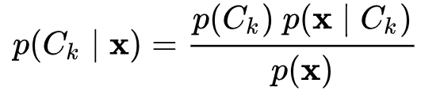
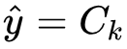
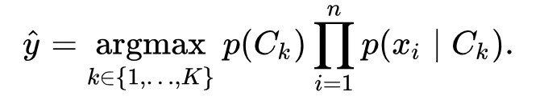
2.6 Naive Bayes classifier /Bayes Rule
Using Bayes' theorem, the conditional probability can be decomposed as
In practice, there is interest only in the numerator of that fraction, because the denominator does not depend on C
The corresponding classifier, a Bayes classifier, is the function that assigns a class label for some k as follows:

Slide 50
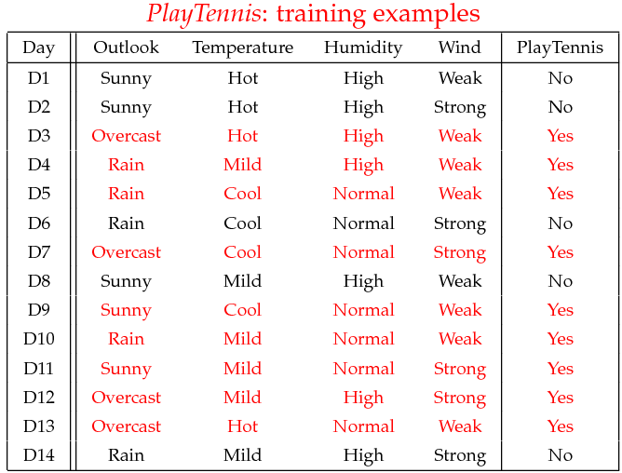
Example
Example: Play Tennis

Slide 51
Learning Phase
P(Outlook|Play)
Outlook | Play=Yes | Play=No
Sunny | 2/9 | 3/5
Overcast | 4/9 | 0/5
Rain | 3/9 | 2/5

Slide 52
Learning Phase
P(Temperature|Play)
Temperature | Play=Yes | Play=No
Hot | 2/9 | 2/5
Mild | 4/9 | 2/5
Cool | 3/9 | 1/5

Slide 53
Learning Phase
P(Humidity|Play)
Humidity | Play=Yes | Play=No
High | 3/9 | 4/5
Normal | 6/9 | 1/5

Slide 54
Learning Phase
P(Wind|Play)
Wind | Play=Yes | Play=No
Strong | 3/9 | 3/5
Weak | 6/9 | 2/5

Slide 55
Learning Phase
P(Outlook|Play) P(Temperature|Play)
Outlook | Play=Yes | Play=No
Sunny | 2/9 | 3/5
Overcast | 4/9 | 0/5
Rain | 3/9 | 2/5
Temperature | Play=Yes | Play=No
Hot | 2/9 | 2/5
Mild | 4/9 | 2/5
Cool | 3/9 | 1/5
P(Humidity|Play) P(Wind|Play)
Humidity | Play=Yes | Play=No
High | 3/9 | 4/5
Normal | 6/9 | 1/5
Wind | Play=Yes | Play=No
Strong | 3/9 | 3/5
Weak | 6/9 | 2/5
P(Play=Yes) = 9/14
P(Play=No) = 5/14

Slide 56
Example
Test Phase
Given a new instance,
x’=(Outlook=Sunny, Temperature=Cool, Humidity=High, Wind=Strong)
Look up tables
MAP rule
P(Outlook=Sunny|Play=Yes) = 2/9
P(Temperature=Cool|Play=Yes) = 3/9
P(Huminity=High|Play=Yes) = 3/9
P(Wind=Strong|Play=Yes) = 3/9
P(Play=Yes) = 9/14
P(Outlook=Sunny|Play=No) = 3/5
P(Temperature=Cool|Play==No) = 1/5
P(Huminity=High|Play=No) = 4/5
P(Wind=Strong|Play=No) = 3/5
P(Play=No) = 5/14
P(Yes|x’): [P(Sunny|Yes)P(Cool|Yes)P(High|Yes)P(Strong|Yes)]P(Play=Yes) = 0.0053
P(No|x’): [P(Sunny|No) P(Cool|No)P(High|No)P(Strong|No)]P(Play=No) = 0.0206
Given the fact P(Yes|x’) < P(No|x’), we label x’ to be “No”.

Slide 57
Event Models
The assumptions on distributions of features are called the event model of the Naive Bayes classifier.
For discrete features like the ones encountered in document classification (include spam filtering), multinomial and Bernoulli distributions are popular.
For Continuous feature , Gaussian naive Bayes distributions is popular.

Slide 58
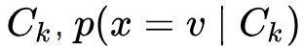
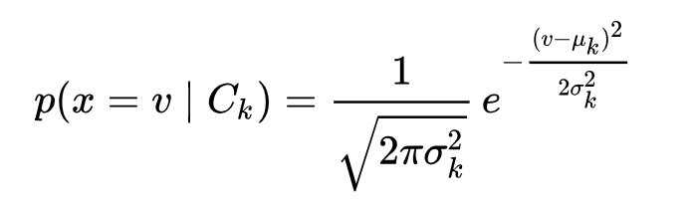
1. Gaussian naive Bayes
When dealing with continuous data, a typical assumption is that the continuous values associated with each class are distributed according to a Gaussian distribution.
Then, the probability distribution of v given a class
can be computed by plugging V into the equation for a Normal distribution parameterized by

Slide 59
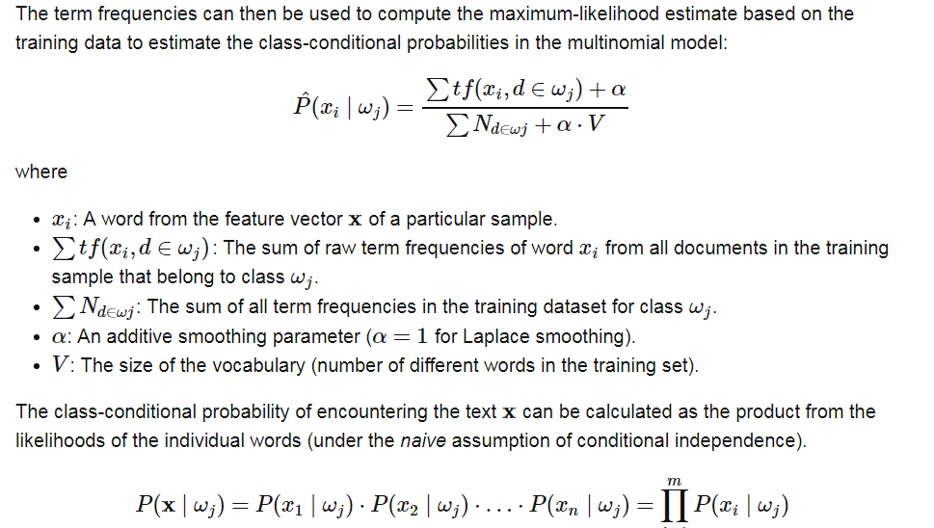
2. Multinomial naive Bayes
Its is used when we have discrete data (e.g. movie ratings ranging 1 and 5 as each rating will have certain frequency to represent). In text learning we have the count of each word to predict the class or label.
The Multinomial Naive Bayes's conditional distribution is:

Slide 60
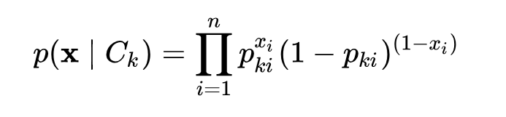
3. Bernoulli naive Bayes
It assumes that all our features are binary such that they take only two values. Means 0s can represent “word does not occur in the document” and 1s as "word occurs in the document" .

Slide 61
3. Bernoulli naive Bayes
It assumes that all our features are binary such that they take only two values. Means 0s can represent “word does not occur in the document” and 1s as "word occurs in the document" .

Slide 62
Lab Program 5:
Write a program to implement the naïve Bayesian classifier for a sample training data set stored as a .CSV file. Compute the accuracy of the classifier, considering few test data sets.

Slide 63
Lab Program 6
Assuming a set of documents that need to be classified, use the naïve Bayesian Classifier model to perform this task. Built-in Libraries can be used to write the program. Calculate the accuracy, precision, and recall for your data set.

Slide 64
Learning to Classify Text – Algorithm
S1: LEARN_NAIVE_BAYES_TEXT (Examples, V)
S2: CLASSIFY_NAIVE_BAYES_TEXT (Doc)
Examples is a set of text documents along with their target values.
V is the set of all possible target values.
This function (S1) learns the probability terms P(wk I vj), describing the probability that a randomly drawn word from a document in class vj will be the English word wk. It also learns the class prior probabilities P(vj).

Slide 65
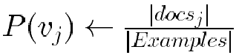
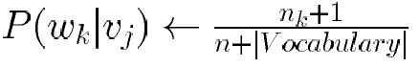
S1: LEARN_NAIVE_BAYES_TEXT (Examples, V)
[ V: Class , W: Word, doc : Documents]
1. collect all words and other tokens that occur in Examples
Vocabulary ← all distinct words and other tokens in Examples
2. calculate the required P(v_{j}) and P(w_{k} | v_{j}) probability terms
For each target value v_{j} in V do
docs_{j} ← subset of Examples for which the target value is v_{j}
Text_{j} ← a single document created by concatenating all members of docs_{j}
n ← total number of words in Text_{j} (counting duplicate words multiple times)
for each word w_{k} in Vocabulary
n_{k} ← number of times word w_{k} occurs in Text_{j}

Slide 66
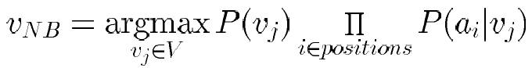
S2:CLASSIFY_NAIVE_BAYES_TEXT (Doc)
positions ← all word positions in Doc that contain tokens found in Vocabulary
Return v_{NB} where

Slide 67
Twenty NewsGroups
Given 1000 training documents from each group Learn to classify new documents according to which newsgroup it came from
Naive Bayes: 89% classification accuracy
comp.graphics comp.os.ms-windows.misc comp.sys.ibm.pc.hardware comp.sys.mac.hardware comp.windows.x | misc.forsale rec.autos rec.motorcycles rec.sport.baseball rec.sport.hockey | alt.atheism soc.religion.christian talk.religion.misc talk.politics.mideast talk.politics.misc talk.politics.guns | sci.space sci.crypt sci.electronics sci.med

Slide 68
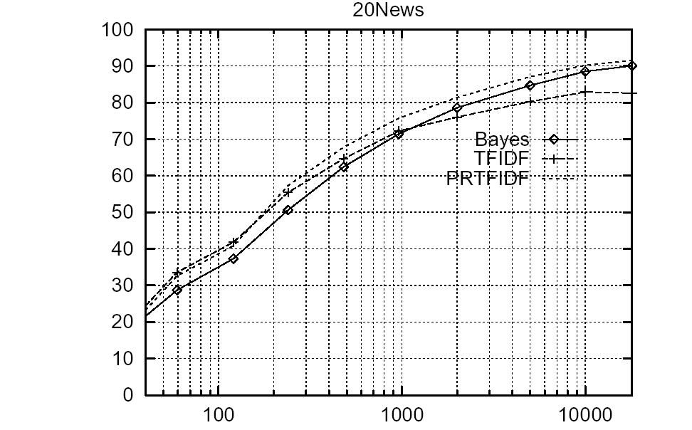
Learning Curve for 20 Newsgroups
Accuracy vs. Training set size (1/3 withheld for test)

Slide 69
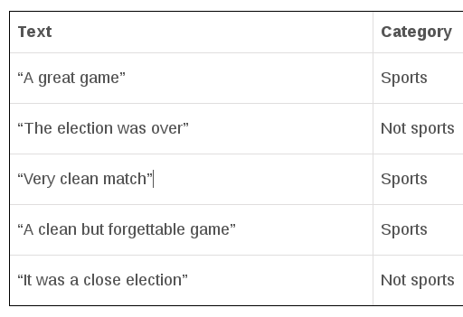
Example :
In the example, we are given a sentence “ A very close game”, a training set of five sentences (as shown below), and their corresponding category (Sports or Not Sports).
The goal is to build a Naive Bayes classifier that will tell us which category the sentence “ A very close game” belongs to.
Applying a Naive Bayes classifier, thus the strategy would be calculating the probability of both “A very close game is Sports”, as well as it’s Not Sports. The one with the higher probability will be the result.

Slide 70
Step 1: Feature Engineering
word frequencies, i.e., counting the occurrence of every word in the document.
P( a very close game) = P(a) X P(very) X P(close) X P(game)
P(a very close game | Sports) = P(a|Sports) X P(Very|Sports) X P(close|Sports) X P(game|Sports)
P(a very close game | Not Sports) = P(a | Not Sports) x P(very | Not Sports) x P(close | Not Sports) x P(game | Not Sports)

Slide 71
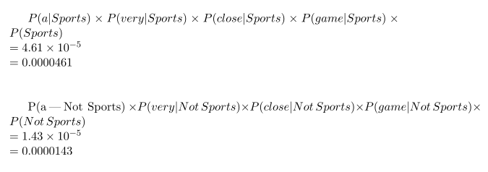
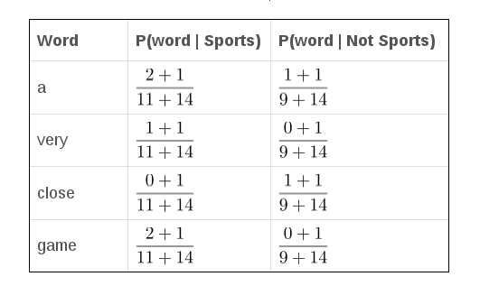
Step 2: Calculating the probabilities
As seen from the results shown below, P(a very close game | Sports) gives a higher probability, suggesting that the sentence belongs to the Sports category.

Slide 72
Source Code

Slide 73
2.7 Bayesian Network (BAYESIAN BELIEF NETWORKS)
Bayesian Belief networks describe conditional independence among subsets of variables

Slide 74
Conditional Independence
Definition: X is conditionally independent of Y given Z if the probability distribution governing X is independent of the value of Y given the value of Z; that is, if
(∀x_{i}, y_{j}, z_{k}) P(X= x_{i}|Y= y_{j}, Z= z_{k}) = P(X= x_{i}|Z= z_{k})
more compactly, we write
P(X|Y, Z) = P(X|Z)
Example: Thunder is conditionally independent of Rain, given Lightning
P(Thunder|Rain, Lightning) = P(Thunder|Lightning)

Slide 75
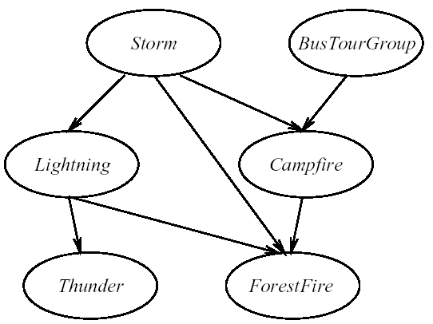
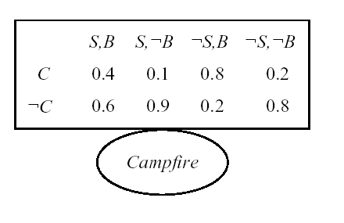
Bayesian Belief Network (1/2)
Network represents a set of conditional independence assertions:
Each node is asserted to be conditionally independent of its non descendants, given its immediate predecessors.
Directed acyclic graph

Slide 76
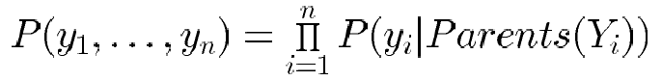
Bayesian Belief Network (2/2)
Represents joint probability distribution over all variables
e.g., P(Storm, BusTourGroup, . . . , ForestFire)
in general,
where Parents(Y_{i}) denotes immediate predecessors of Y_{i} in graph
so, joint distribution is fully defined by graph, plus the P(y_{i}|Parents(Y_{i}))

Slide 77
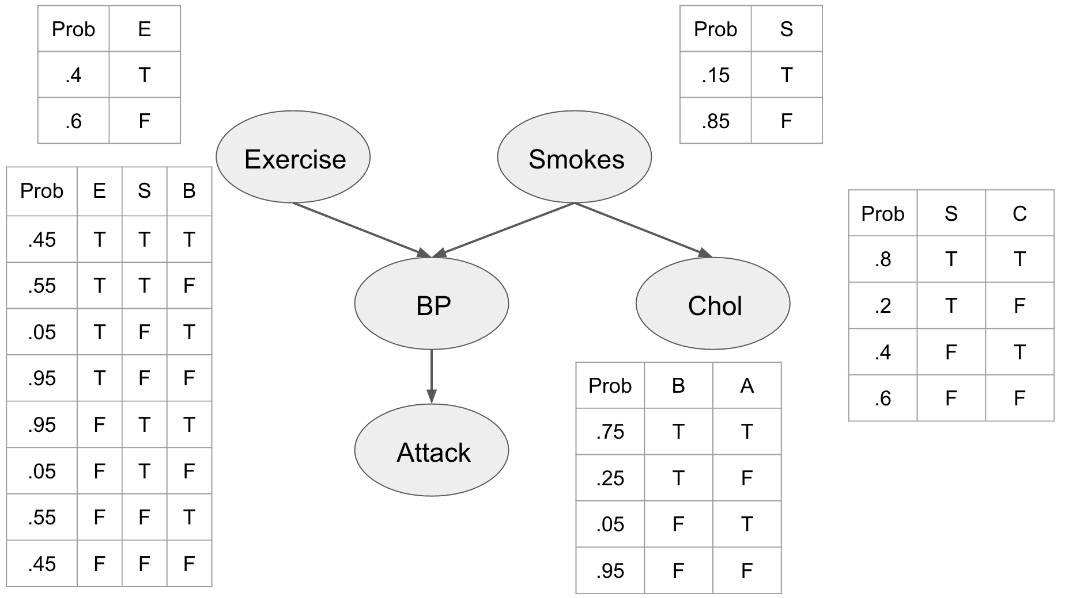

Slide 78
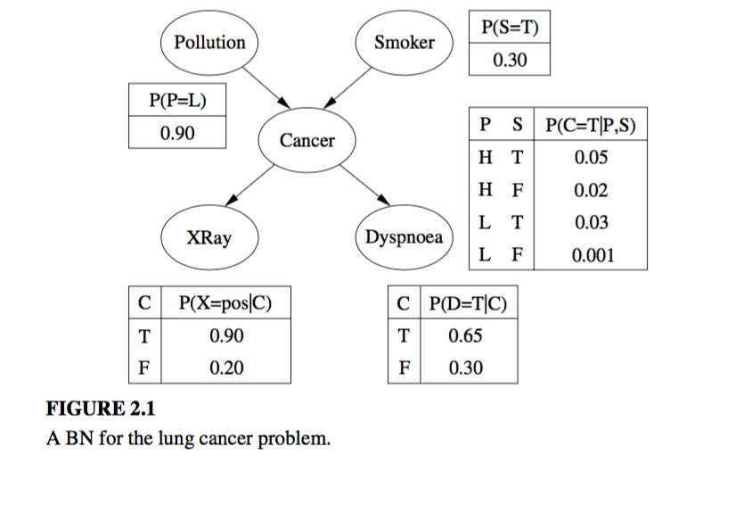

Slide 79
Lab Program 7
Write a program to construct a Bayesian network considering medical data. Use this model to demonstrate the diagnosis of heart patients using standard Heart Disease Data Set. You can use Python ML library API.

Slide 80
Source Code

Slide 81
2.8 EM Algorithm

Slide 82
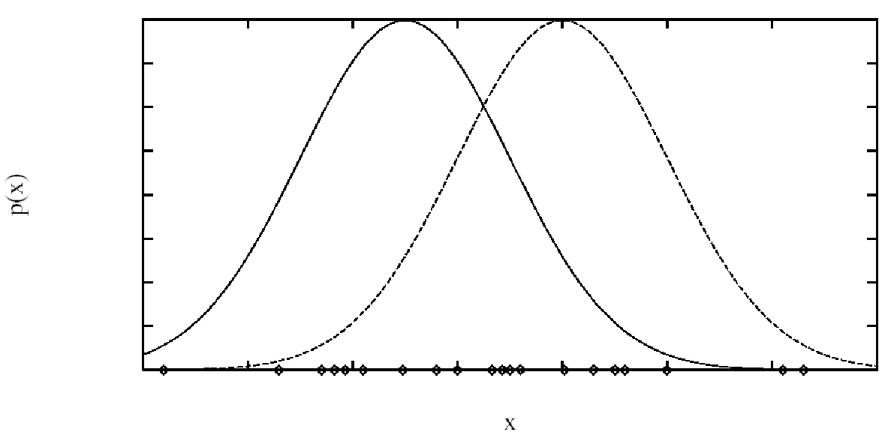
Generating Data from Mixture of k Gaussians
Each instance x generated by
1. Choosing one of the k Gaussians with uniform probability
2. Generating an instance at random according to that Gaussian

Slide 83
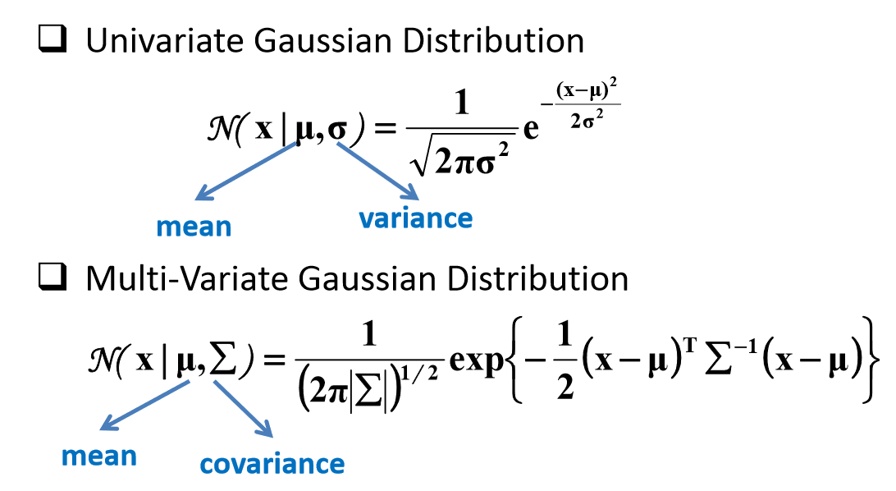
Gaussian Distribution

Slide 84
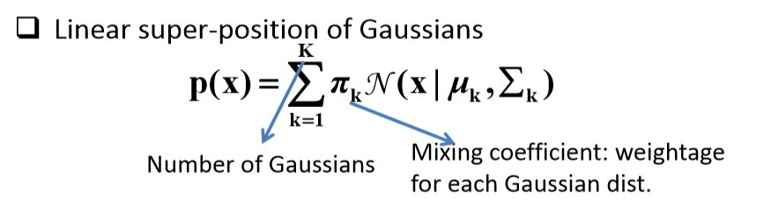
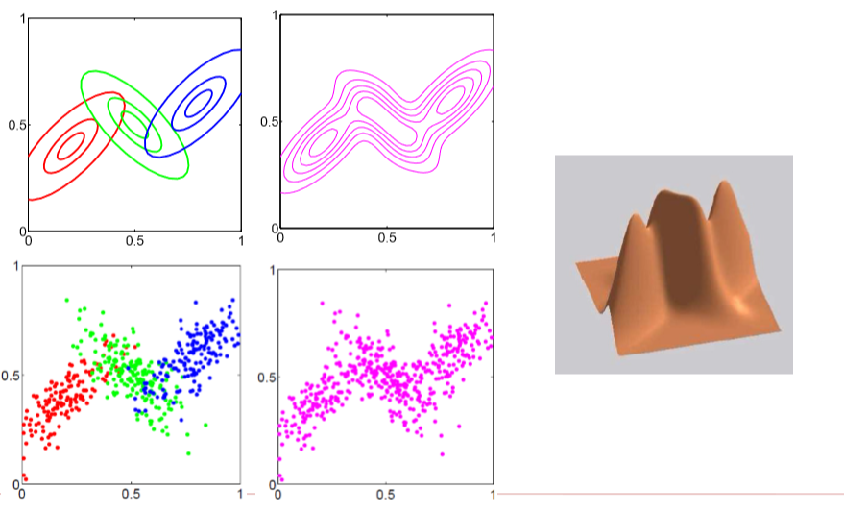
Gaussian Mixtures

Slide 85
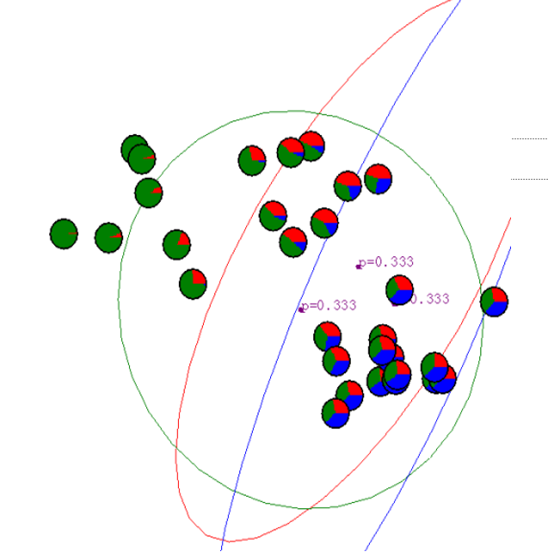
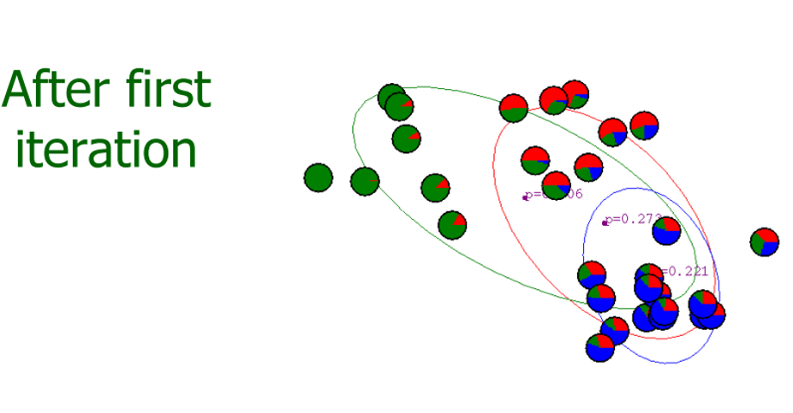
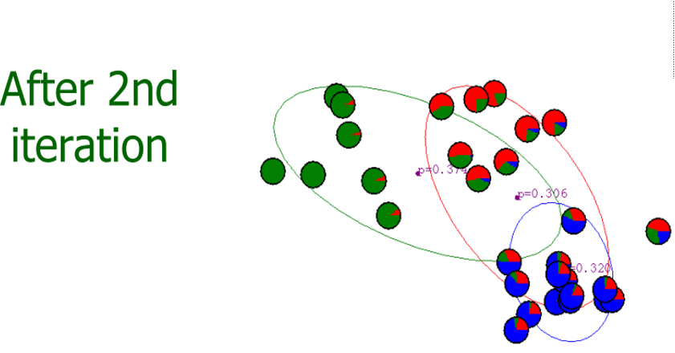





GMM : Example

Slide 86
Expectation Maximization (EM) Algorithm
When to use:
Filling in missing data in samples
Unsupervised learning of clusters
Semi-supervised classification and clustering

Slide 87
Expectation Maximization (EM) Algorithm
EM is typically used to compute maximum likelihood estimates given incomplete samples.
The EM algorithm estimates the parameters of a model iteratively.
Starting from some initial guess, each iteration consists of
an E step (Expectation step)
an M step (Maximization step)

Slide 88


EM Algorithm
Given:
Instances from X generated by mixture of k Gaussian distributions
Unknown means <μ₁,…,μ_{k} > of the k Gaussians
Don’t know which instance x_{i} was generated by which Gaussian
Determine:
Maximum likelihood estimates of <μ₁,…,μ_{k} >
EM Algorithm:
Pick random initial h = <μ₁, μ₂> then iterate
E step: Calculate the expected value E[z_{ij}] of each hidden variable z_{ij}, assuming the current hypothesis
h = <μ₁, μ₂> holds.
M step: Calculate a new maximum likelihood hypothesis h' = <μ'₁, μ'₂>, assuming the value taken on by each hidden variable z_{ij} its expected value E[z_{ij}] calculated above. Replace h = <μ₁, μ₂> by h' = <μ'₁, μ'₂>.

Slide 89

GMM :

Slide 90

GMM : Example2

Slide 91


GMM : Example2

Slide 92


GMM : Example2

Slide 93


GMM : Example2

Slide 94
Web links , G- Mail and Contact Number
https://github.com/profthyagu
http://proftgs.blogspot.com
Gmail1: profthyagu@gmail.com
Gmail2 : innovationscontext@gmail.com
Mobile : 9480123526

Slide 95
Agenda
Day1 | Fundamentals of Machine Learning: Introduction to Machine Learning and its Applications, Machine Learning Python Tools. Simple machine learning application. Data Preprocessing: Data Sets, Classic Data Sets, What is Data Preprocessing ?, Need of Data Preprocessing , Data Preprocessing Steps: Importing the useful packages/libraries , Defining Sample Data , Applying Preprocessing Techniques like Scaling , Standardization , Normalization , Mean Removal and Labelling the Data .
Day2 | Types of Machine Learning Algorithms Bayesian Learning: Bayes Theorem and Concept Learning, ML and LS error Hypothesis, Naïve Bayes Classifier, Bayesian belief networks, EM Algorithm
Day 3 | Instance Based Learning: Introduction, K-nearest neighbor learning, locally weighted regression, radial basis function, cased based reasoning. Reinforced Learning: Introduction, Learning Task, Q Learning

Slide 96
EM Algorithm
Given:
Instances from X generated by mixture of k Gaussian distributions
Unknown means <μ₁,…,μ_{k} > of the k Gaussians
Don’t know which instance x_{i} was generated by which Gaussian
Determine:
Maximum likelihood estimates of <μ₁,…,μ_{k} >
EM Algorithm:
Pick random initial h = <μ₁, μ₂> then iterate
E step: Calculate the expected value E[z_{ij}] of each hidden variable z_{ij}, assuming the current hypothesis
h = <μ₁, μ₂> holds.
M step: Calculate a new maximum likelihood hypothesis h' = <μ'₁, μ'₂>, assuming the value taken on by each hidden variable z_{ij} its expected value E[z_{ij}] calculated above. Replace h = <μ₁, μ₂> by h' = <μ'₁, μ'₂>.

Slide 97
GMM :

Slide 98
K Means Algorithm
1. The sample space is initially partitioned into K clusters and the observations are randomly assigned to the clusters.
2. For each sample:
Calculate the distance from the observation to the centroid of the cluster.
IF the sample is closest to its own cluster THEN leave it ELSE select another cluster.
3. Repeat steps 1 and 2 untill no observations are moved from one cluster to another

Slide 99


K Means Algorithm

Slide 100


Slide 101

Centroid with respect to three points

Slide 102


Slide 103

Examples of K Means

Slide 104
Lab Program 8
Apply EM algorithm to cluster a set of data stored in a .CSV file. Use the same data set for clustering using k-Means algorithm. Compare the results of these two algorithms and comment on the quality of clustering. You can add Python ML library classes/API in the program.

Slide 105
Source Code

